Slide 1
MVC WIREFRAME

Slide 2
START

Slide 3
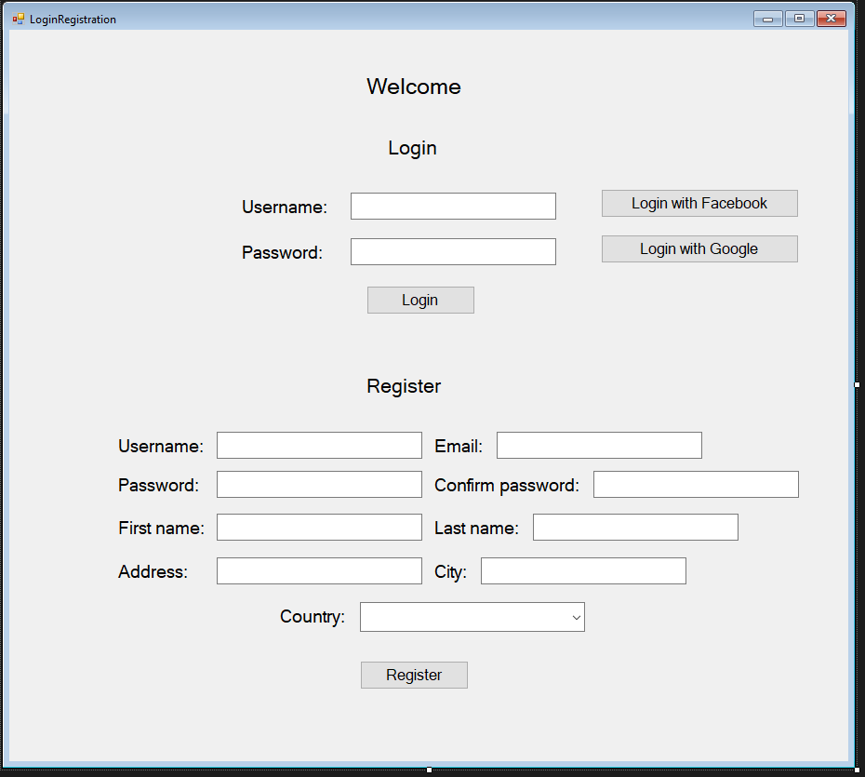

Slide 4
MAIN MENU

Slide 5
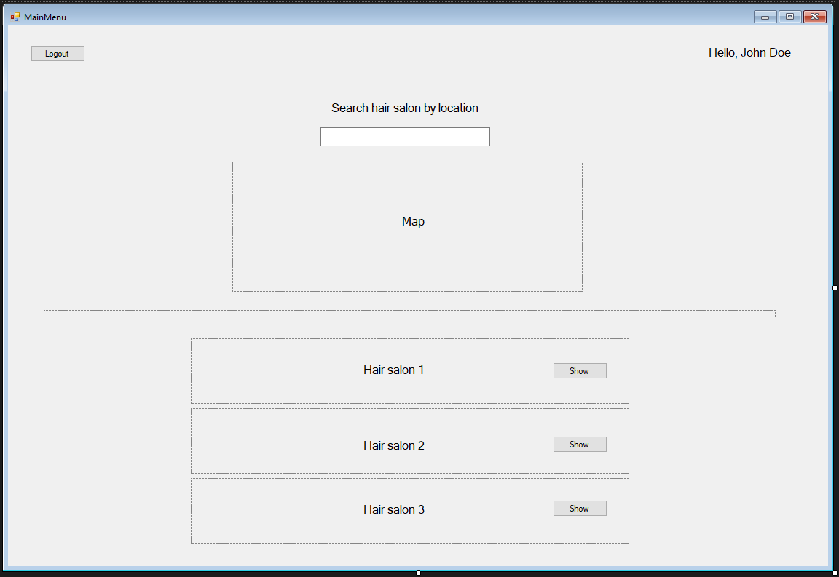

Slide 6
HAIR SALON

Slide 7
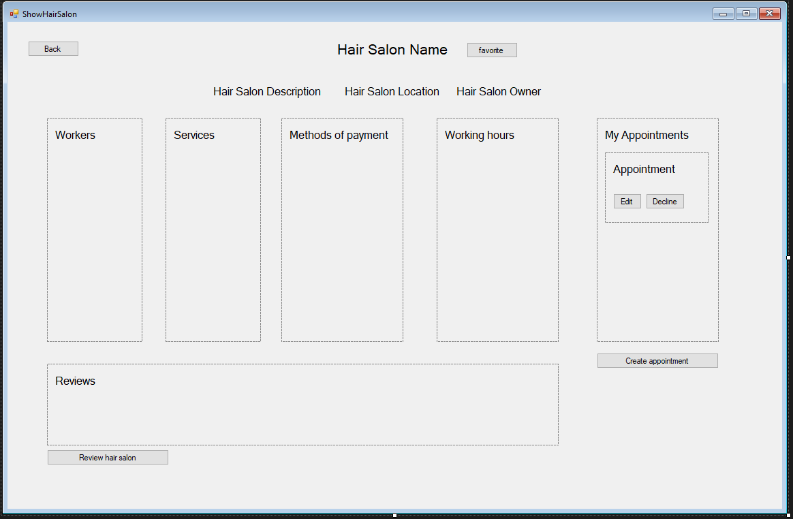

Slide 8
APPOINTMENT

Slide 9
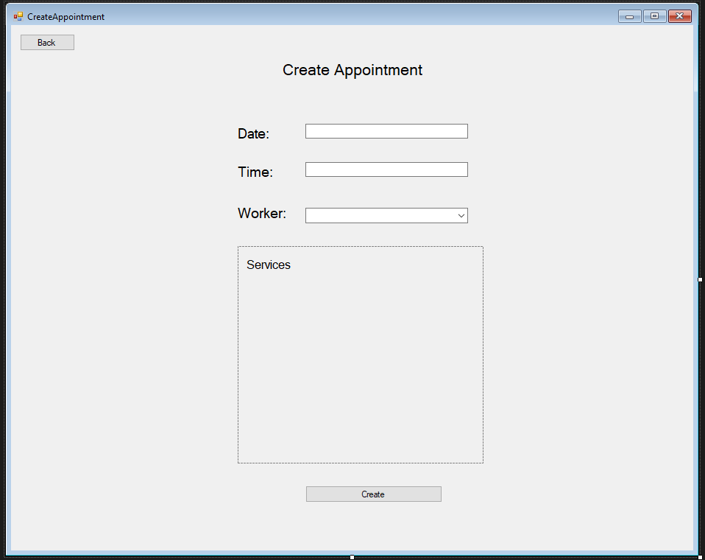

Slide 10
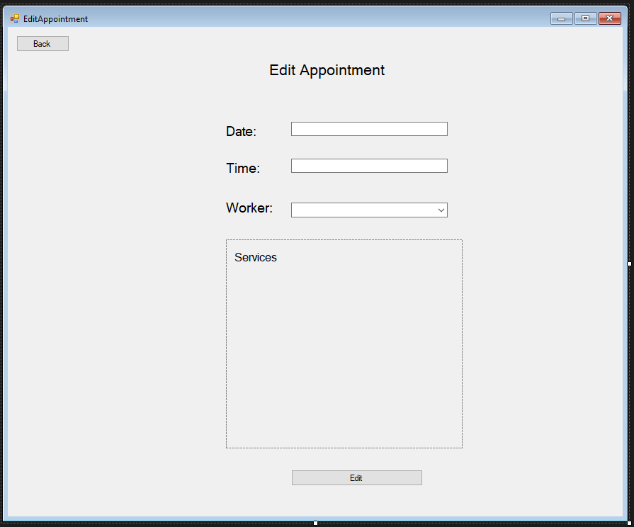

Slide 11
REVIEW

Slide 12
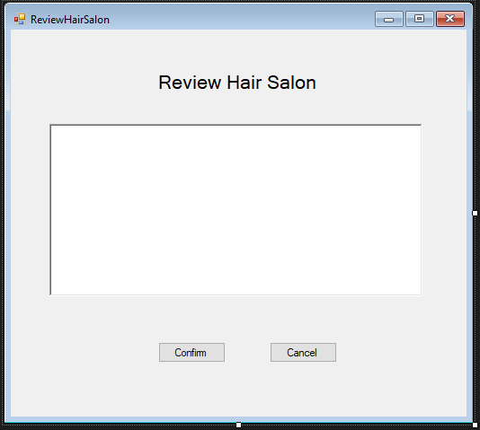

Slide 13
USER PROFILE

Slide 14
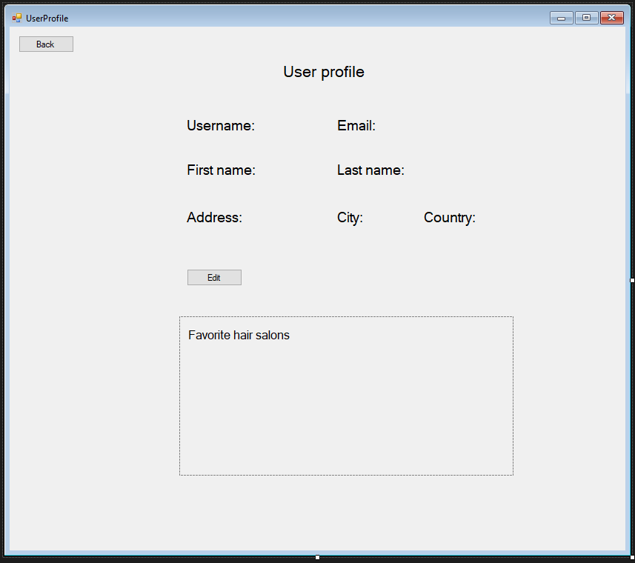

Slide 15
